Slide 1
Human resources slide 1
HR ANALYTICS EMPLOYEE RETENTION
P 391
Group : 4
DATE: 17-03-2024

Slide 2
Human resources slide 2
TEAM MEMBERS
Mr. Vishal Mule
Ms. Shravani Tamanna
Mr. Avinash Bhawasar
Mrs. Bhagyashri Gore
Mr. Palash Gupta
Ms. Ria Singh
Mr. Usman Gani Farid Mansuri

Slide 3
Human resources slide 2
AGENDA
Introduction
Project Description
KPI
Tech Used
Dashboard
Insights and Recommendation
Summary and Conclusion

Slide 4

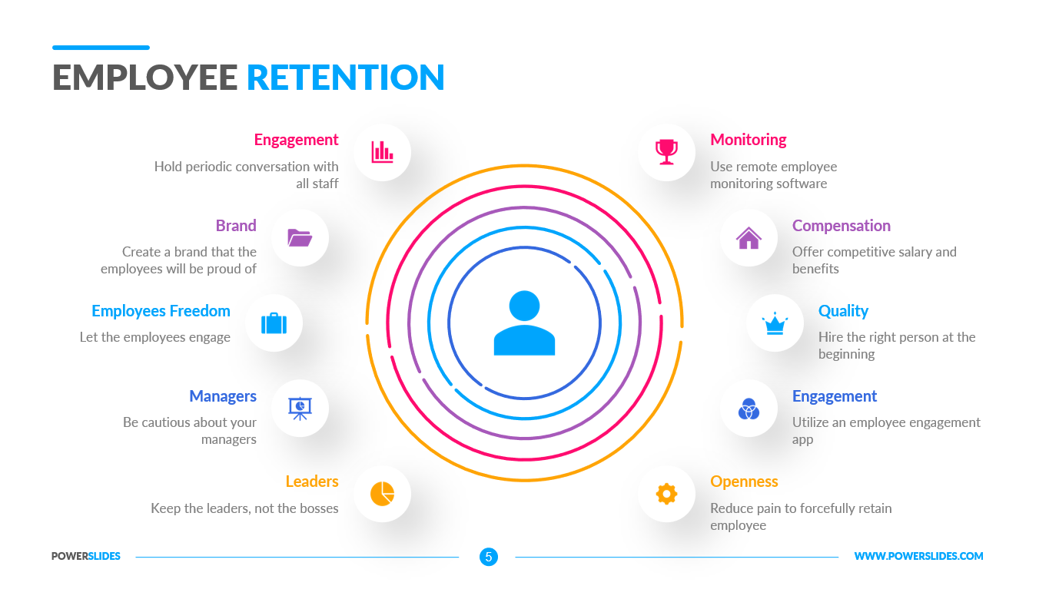
Human resources slide 3
INTRODUCTION
What is Employee Retention ?
Employee Retention is the ability of an organization to retain its employees and ensure sustainability. Employee retention can be represented by a simple statistic. Employee retention is also the strategies employers use to try retain the employees in their workspace.
Why is it so important ?
High retention reduces lost knowledge, hiring expenses and missed revenue opportunities. It amplifies workers contributions, allowing you to make the most of the talent you have and retention drives better performance and improved business outcomes over the long term while delighting your clients and customers.

Slide 5
Human resources slide 3
PROJECT DISCRIPTION
The given project asks us to apply Analytics by analysing the data given for HR Analytics
The project expects us to perform Exploratory Data Analysis to understand how to retain employees and reduce the attrition.
By EDA ,Visualization we will identify those factor by which employees are resigning and get Insights from it and the factors which boost Employee Retention.
We are expected to manage missing data, identify Null Values, report any data imbalance, Performs ETL Process, Data base creation, writing SQL Queries and finally Convert Data into Visuals to extract meaningful insights using Visualization Tool.

Slide 6
Human resources slide 2
KPI’s
Average Attrition rate for all Departments
Average hourly rate of male research scientist
Attrition Rate VS Monthly income stats
Average working years for each department
Job role vs work life balance
Attrition rate vs year since last promotion relation

Slide 7
Human resources slide 4

Slide 8
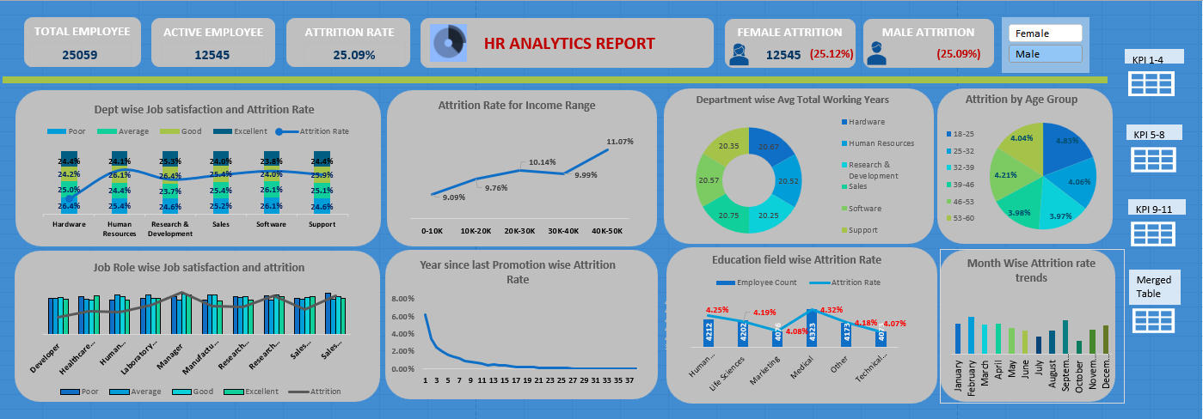
Excel Dashboard

Slide 9
Human resources slide 6

Slide 10
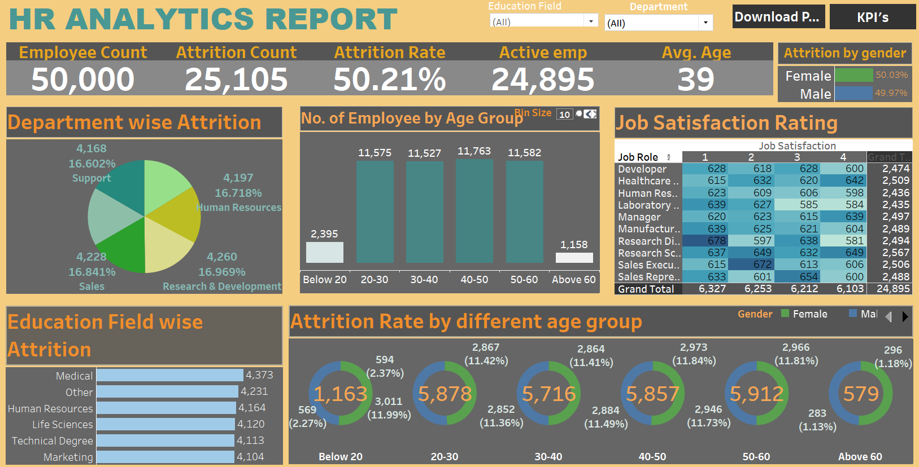
Tableau Dashboard

Slide 11

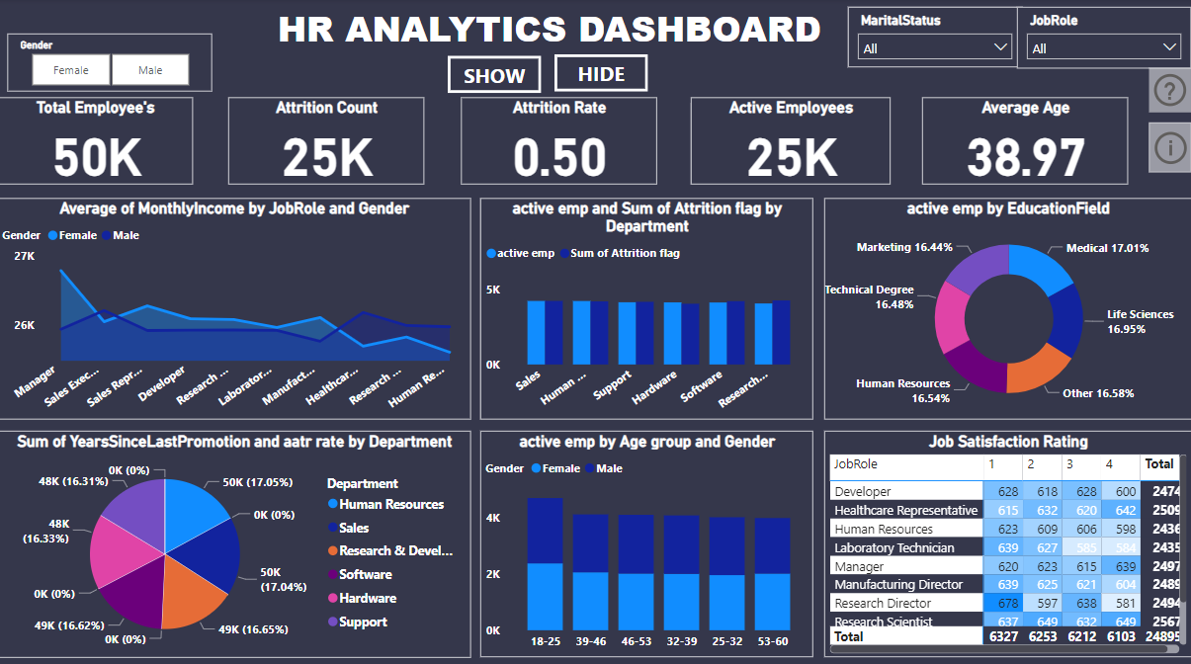
Human resources slide 8
Power BI Dashboard

Slide 12
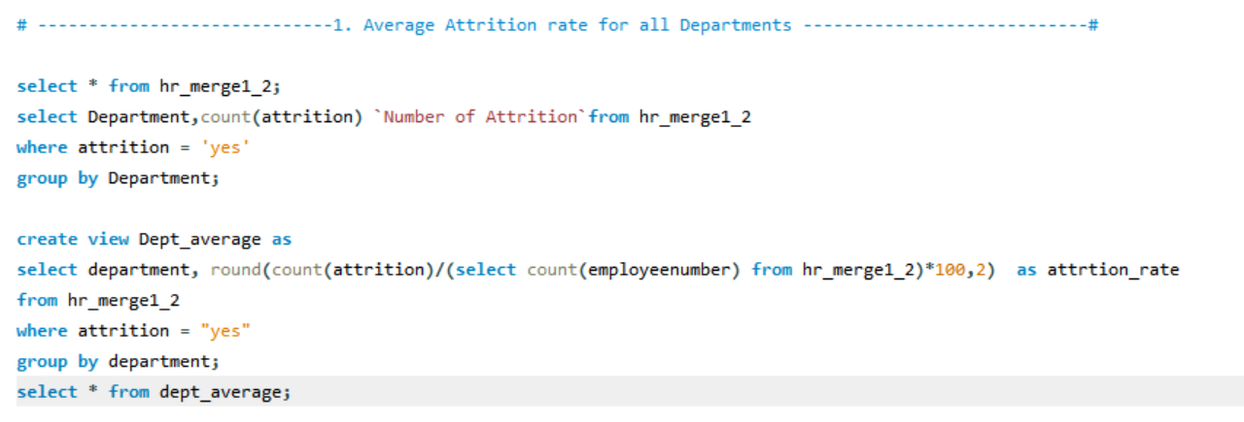
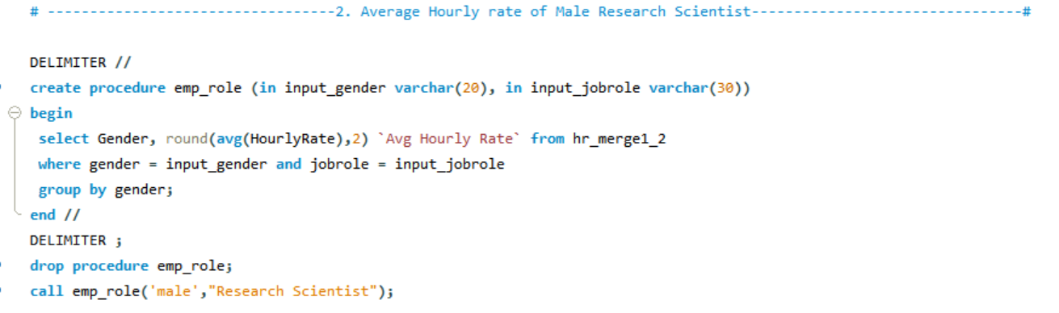
My SQL Querries

Slide 13
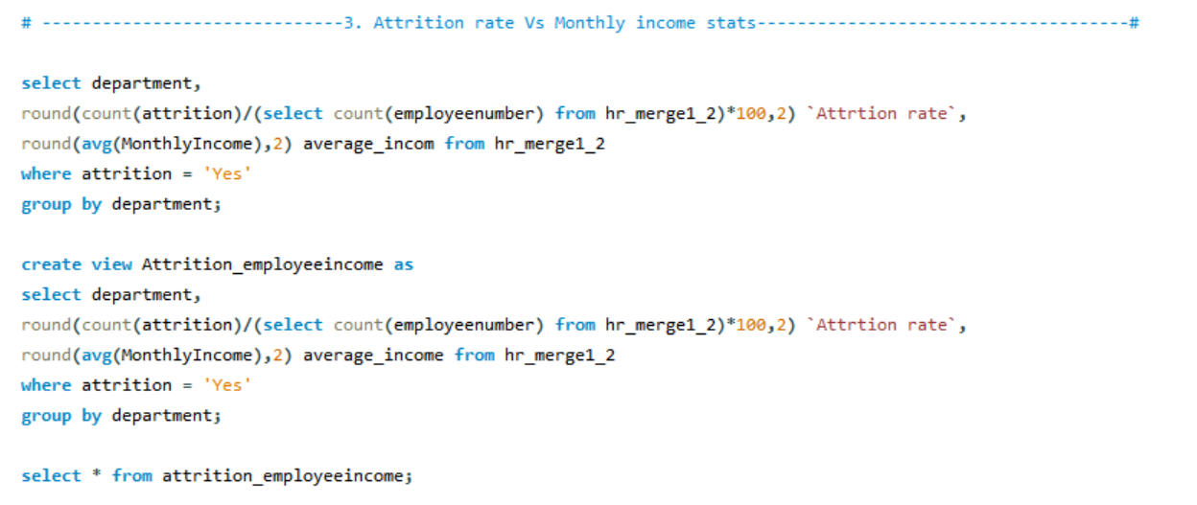
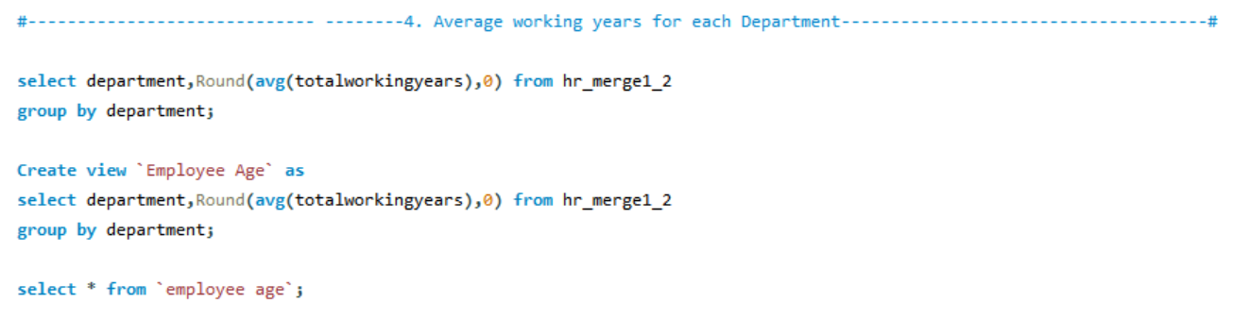

Slide 14
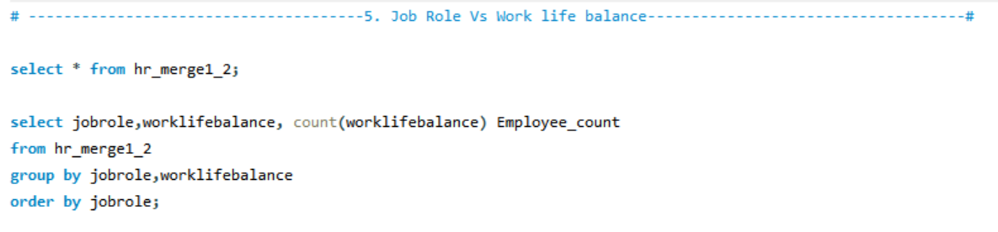
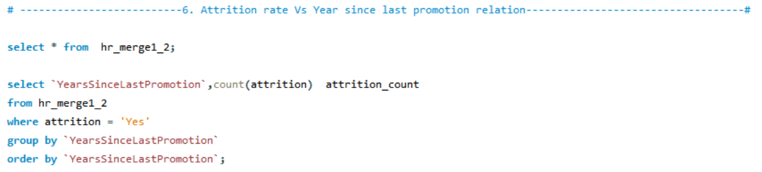
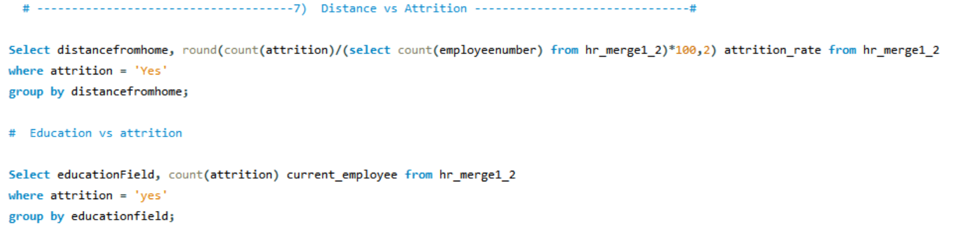

Slide 15
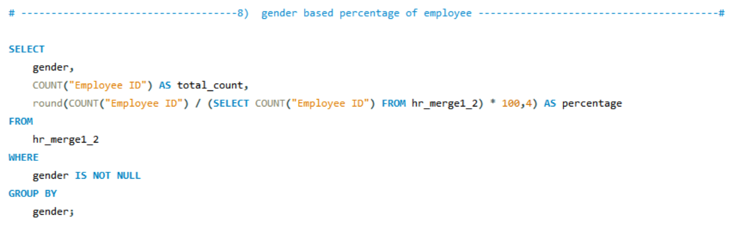
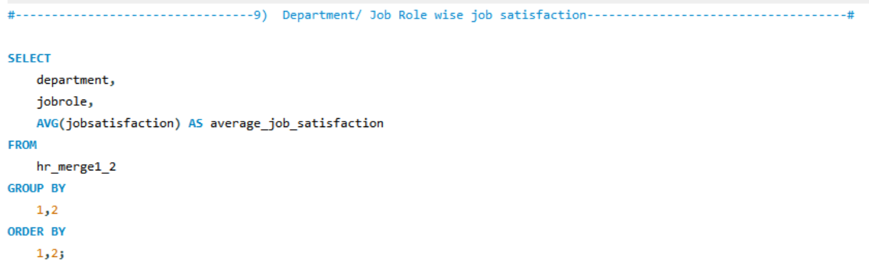
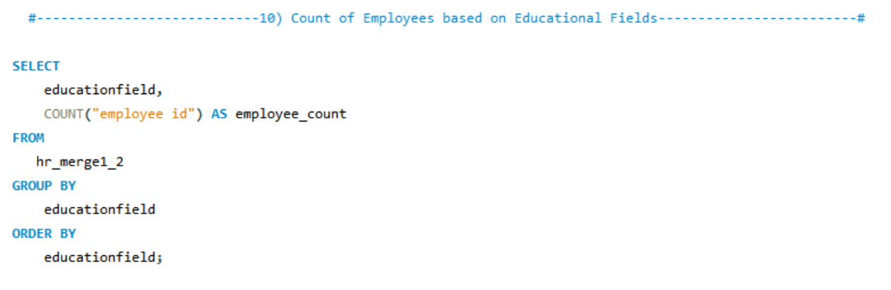

Slide 16
Summary
The Employee Retention Project aims to analyze turnover factors and implement targeted strategies to enhance employee satisfaction and retention. Through comprehensive assessment, we'll identify areas for improvement in compensation, career development, and workplace culture. By fostering a positive work environment and providing growth opportunities, we aim to reduce turnover rates and boost employee morale. Our goal is to create a more stable and successful organization through effective retention initiatives. Join us in building a workplace where employees feel valued and empowered to thrive.

Slide 17
Human resources slide 10
Thank You

